Slide 1
Discovering Evolutionary Theme Patterns from Text
- An Exploration of Temporal Text Mining
Vikram Pudi
WDKM

Slide 2
Motivation
Most text collections bear time stamps
  News articles, scientific literature, emails, etc.
Many useful temporal patterns exist
  Emerging topics/themes
  Decaying topics/themes
  Topic evolution thread
  Topic/theme life cycles
  …
How do we discover and exploit such patterns?
Notes:
Put the last part

Slide 3
TTM-Temporal Text Mining
Discovering latent themes from text
Constructing an evolution graph of themes
Analyzing life cycles of themes

Slide 4
Theme Evolution Graph (Asia Tsunami)
Time
Theme evolution thread
Statistics of Death
and loss
Immediate Reports
Statistics of further
impact
Personal Experience
of Survivors
Donations from
countries
Aid from Local Areas
Aid from the world
…
Doc1
Doc3
Doc ..
Specific Events of Aid
…
Lessons from Tsunami
Research inspired
Theme spans
Evolutionary transitions
Useful for summarizing the news…
Notes:
Explain the Plots. Temporal theme analysis separate to make the fonts bigger… more explanations.
Title: sample ETP: theme evolutionary graph

Slide 5
Theme Life Cycle (SIGIR Proceedings)
Theme Strength
Time
1980
1990
1998
2003
TF-IDF Retrieval
Language Model
IR Applications
Text Categorization
Useful for revealing historical trends and hot topics…
Notes:
Explain the Plots. Temporal theme analysis separate to make the fonts bigger… more explanations.
Title: sample ETP: theme evolutionary graph

Slide 6
Problem Definition
Evolutionary Theme Pattern (ETP)
  Theme Evolution Graph
    A weighted directed graph in which each vertex is a theme span and each edge is an evolutionary transition
  Theme Life Cycle
    The strength of a theme over the whole time line
Given a text collection with time stamps, the problem of discovering ETP is to
  Extract a theme evolution graph
  Model the life cycles of the most salient themes
Notes:
Need a picture to introduce the concepts.. Use the summarization graph in the previous slide
A picture like in the results..

Slide 7
Research Questions
How to represent a theme?
How to extract themes from a collection automatically?
How to model the transitions of themes?
How to segment the collection with themes?
How to model and compute the strength of each theme at a given time period?

Slide 8
Our Approach
Theme Life cycles
Theme Evolution Graph
t
s
Computing Theme Strength
θ₁₁
θ₃₁
Task II. Transition Modeling
θ₂₁
θ₁₂
…
t
θ₂₂
θ₁₃
θ_{3k}
…
…
…
…
Model theme transitions
Decoding Collection
t
Task III. Theme Segmentation
θ₁
θ₂
Theme spans extraction
Model theme shifts
B
θ₃
Task I. Theme Extraction
Partitioning
Extracting global salient themes
Collection with time stamps
t1 t2 t3, …, t
Notes:
Stay long enough

Slide 9
Our Approach (Cont.)
Extracting Theme Evolution Graph
  Partition collection into time intervals
  Extract themes from each time span (task I)
  Model transitions between theme spans (task II)
Modeling theme life cycles
  Extract most salient themes from the whole collection (task I)
  Segment the collection with themes (task III )
  Compute the strength of each theme over time

Slide 10

Theme Extraction
Extract themes from each sub collection using a simple probabilistic mixture model
In this method, words are regarded as data drawn from mixture model with component models for the theme word distributions and a background word distribution.
Words in the same document share the same mixing weights.
The model can be estimated using the EM algorithm to obtain the theme word distributions

Slide 11





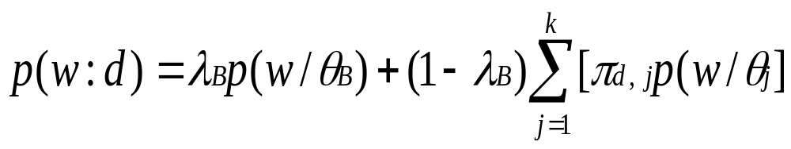
Theme Extraction Continued…
Let be theme unigram language models i.e. word distributions
be the background model for the whole collection
A document is regarded as a sample of the following mixture model

Slide 12



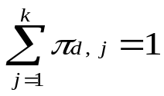



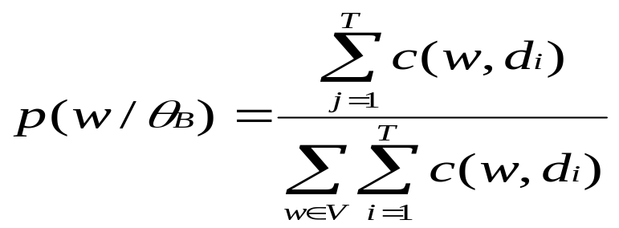
Theme Extraction Continued…
Where is a word in document
is the mixing weight for document for choosing the –th theme such that
is the mixing weight for
is estimated using the whole collection as

Slide 13


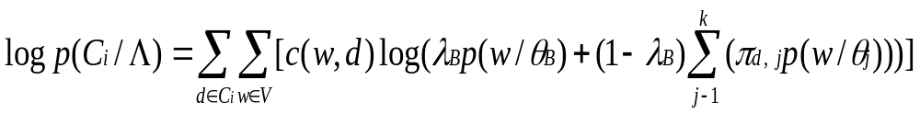
Theme Extraction Continued…
For parameters estimation Maximum
Likelihood(ML) estimator is using i.e.
Where
The log-likelihood of is

Slide 14

Theme Extraction Continued…
The EM algorithm can be used to estimating all the parameters
The algorithm is only guaranteed to find a local maximum of the likelihood
Multiple trails will be used to improve the local maximum
use to measure the salience of theme
in and select the most salient themes from
by using an empirically set threshold.

Slide 15
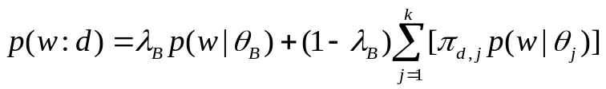
Task I: Theme Extraction
There are k themes in the collection (or a time span), each document is a sample of words generated by multiple themes
Infer the best theme language models that fit our data
Document d
warning 0.3 system 0.2..
Theme θ₁
π_{d,1}
?
θ₁
“Generating” word w
in doc d in the collection
Aid 0.1
donation 0.05
support 0.02 ..
θ₂
Theme θ₂
?
π_{d,2}
1 - λ_{B}
?
π_{d, k}
W
…
θ_{k}
?
statistics 0.2
loss 0.1
dead 0.05 ..
λ_{B}
Theme θ_{k}
?
?
B
Is 0.05
the 0.04
a 0.03 ..
Background B
Parameters:
λ_{B}=noise-level (manually set)
θ’s and π’s are estimated with Maximum Likelihood

Slide 16
Task II: Transition Modeling
Theme spans in an earlier time interval could evolve into theme spans in a later time interval
t1
…
t2
T
microarray 0.2
gene 0.1
protein 0.05
?
B
Information 0.2
topic 0.1 classification 0.1
text 0.05
A
?
web 0.3
classification 0.1
topic 0.1
C
Evolutionary Transition
=
Theme
similarity
Similarity/distance between two theme spans is modeled with KL Divergence between two distributions
Notes:
“Transition = Theme similarity” pictures?

Slide 17
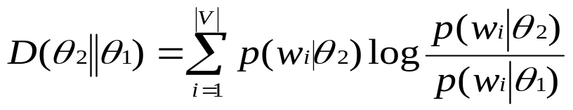
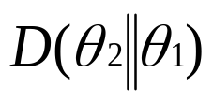
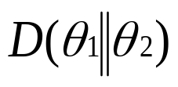


Evolution Transition Discovery
To discover any evolutionary transition between two theme spans, Kullback-Leibler divergence has been used to measure their evolution distance
Natural measure of evolution distance between two themes is given by
Note:KL-divergence is asymmetric and it makes more sense to use than to measure the evolution distance from to

Slide 18





Continued…
For every pair of theme spans and
where compute
If is above a threshold we will infer that
The threshold allows a user to flexibly control the strength of the theme transitions

Slide 19
Theme Evolution Graph
After extracting theme spans from all the collections and identify all the evolutionary transitions, we have a theme evolution graph.
Theme Evolution Graph gives us a microcosmic view of the ETPs - revealing the major theme spans within each time interval and their evolutionary structures.
To obtain a macroscopic view of the ETPs,it would be useful to extract the global evolutionary patterns of themes over the whole text stream and analyze the “life cycle” of the specific theme.

Slide 20
Theme Life Cycle
Theme Life Cycle of each theme is the strength distribution of the theme over the entire time line
The strength of a theme at each time period is measured by the number of words generated by this theme in the documents corresponding to this time period
The strength normalized by either the number of time points (i.e.absolute strength), or the total no of words in the period (i.e. a relative strength)

Slide 21
Continued…
The absolute strength measures the absolute amount of text which a theme can explain
The relative strength indicates which theme is relatively stronger in a time period
HMMs method is used to model and decode the shift between trans-collection themes in the whole collection
Based on decoding results, we can compute the theme strengths and analyze theme life cycles

Slide 22
Task III: Theme Segmentation
View the whole collection as a sequence ordered by time, Model the theme shifts in documents with a Hidden Markov Model
w
w
w
w
w
w
w
w
w
w
w
w
w
w
w
w
w
w
w
…
…
Background
Decoding Collection
Theme θ₁
θ₁
θ₂
Theme θ₂
B
θ₃
Train transition probabilities
Theme θ₃
The Collection
output probability
=
P (w|θ)
Notes:
A bit more time to explain what is an HMM
A word with a larger probability to be generated by theme1 would be…

Slide 23
Analysis of Theme Life Cycles
Construct an HMM to model how themes shift between each other in the collections.
Estimate the unknown parameters of the HMM using the whole stream collection as observed example sequence.
Decode the collection and label each word with hidden theme model from which it is generated.
For each trans-collection theme, analyze when it starts, when it terminates, and how it varies over time.

Slide 24
Our Approach: Revisit
Theme Life cycles
Theme Evolution Graph
t
s
Computing Theme Strength
θ₁₁
θ₃₁
θ₂₁
θ₁₂
…
t
θ₂₂
θ₁₃
θ_{3k}
…
…
…
…
Model theme transitions
Decoding Collection
t
θ₁
θ₂
Theme spans extraction
Model theme shifts
B
θ₃
Partitioning
Extracting global salient themes
Collection with time stamps
t1 t2 t3, …, t
Notes:
Stay long enough

Slide 25
Experiments
Two data sets:
  Asia Tsunami: 7468 news articles spanning 50 days (Dec 19 2004 to Feb. 8 2005) from 10 news sources
  KDD Abstracts: 496 abstracts from 6 years’ KDD conference proceedings from 1999 to 2004
Notes:
Show the picture again, revisit the approach.

Slide 26
On each data sets, two experiments are designed:
(1) Partition the collection into time intervals, discover the theme evolution graph and identity theme evolution threads
(2)Discover trans-collection themes and analyze their life cycles

Slide 27
Theme Evolution Graph: Tsunami
12/28/04
01/05/05
01/15/05
…
T
system 0.0104
Bush 0.008
warning 0.007
conference 0.005
US 0.005
…
aid 0.020
relief 0.016
U.S. 0.013
military 0.011
U.N. 0.011
…
…
…
Bush 0.016
U.S. 0.015
$ 0.009
relief 0.008
million 0.008
…
Indonesian 0.01
military 0.01
islands 0.008
foreign 0.008
aid 0.007
…
system 0.008
China 0.007
warning 0.005
Chinese 0.005
…
warning 0.012
system 0.012
Islands 0.009
Japan 0.005
quake 0.003
…
…
…
…
…
…

Slide 28
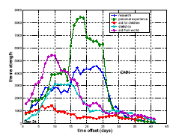
Theme Life Cycles: Tsunami
$ 0.0173
million 0.0135
relief 0.0134
aid 0.0099
U.N. 0.0066
…
Aid from the world
Personal experiences
Research
Aid for children
statistics
I 0.0322
wave 0.0061
beach 0.0051
saw 0.0046
sea 0.0046
…
CNN, Absolute Strength

Slide 29
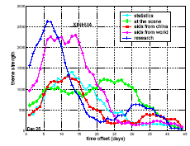
Theme Life Cycles: Tsunami
Aid from the world
dollars 0.0226
million 0.0204
aid 0.0118
U.N. 0.0102
reconstruction
0.0062 …
Scene and Experiences
Research
Aid from China
statistics
China 0.0391
yuan 0.0180
Beijing 0.0089
$ 0.0058
donation 0.0052
…
XINHUA News, Absolute Strength

Slide 30
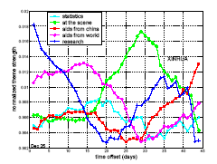
Theme Life Cycles: Tsunami
$ 0.0173
million 0.0135
relief 0.0134
aid 0.0099
U.N. 0.0066
…
Aid from the world
Scene and Experiences
Research
Aid from China
statistics
China 0.0391
yuan 0.0180
Beijing 0.0089
$ 0.0058
donation 0.0052
…
XINHUA News , Normalized Strength

Slide 31
Theme Evolution Graph: KDD
1999
2000
2001
2002
2003
2004
T
web 0.009
classifica –tion 0.007
features0.006
topic 0.005
…
SVM 0.007
criteria 0.007
classifica – tion 0.006
linear 0.005
…
mixture 0.005
random 0.006
cluster 0.006
clustering 0.005
variables 0.005
…
topic 0.010
mixture 0.008
LDA 0.006
semantic
0.005
…
decision 0.006
tree 0.006
classifier 0.005
class 0.005
Bayes 0.005
…
…
Classifica
- tion 0.015
text 0.013
unlabeled 0.012
document 0.008
labeled 0.008
learning 0.007
…
Informa
- tion 0.012
web 0.010
social 0.008
retrieval 0.007
distance 0.005
networks 0.004
…
…
…
…

Slide 32
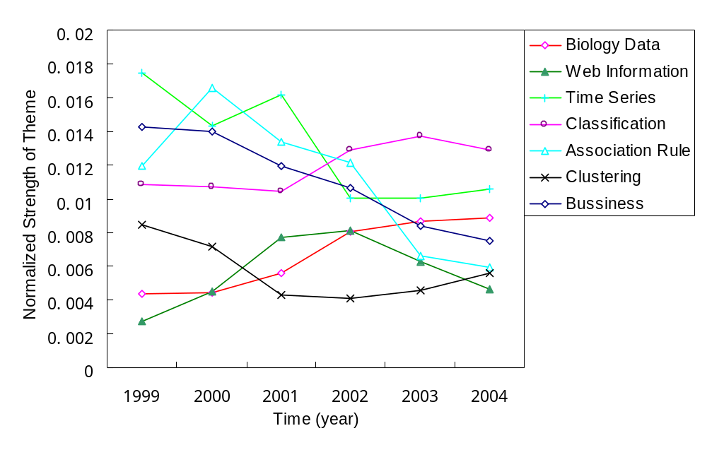
Theme Life Cycles: KDD
gene 0.0173
expressions 0.0096
probability 0.0081
microarray 0.0038
…
marketing 0.0087
customer 0.0086
model 0.0079
business 0.0048
…
rules 0.0142
association 0.0064
support 0.0053
…
Global Themes life cycles of KDD Abstracts

Slide 33
Related Work
Kleinberg’s discovered brusty and hierarchical structures in streams, text streams are converted to temporal frequency data and an infinite-state automation is used to model the stream
Several researchers has been studied about detection of novel topics and trends in text streams, but their focus is to identify emerging trends rather than summarize the complete evolutionary theme patterns in a given text stream

Slide 34
Continue…..
Nallapati and others studied how to discover sub-clusters in a news event and structure them by their dependency, which could also generate a graph structure.
A major difference between this work and theirs is that they perform document level clustering, while we perform theme level word clustering.
Another difference is that they do not consider variations of subtopics in different time period while we analyze life cycles of themes.

Slide 35
Summary
We defined a new problem of temporal text mining, which is to discover evolutionary theme patterns from text stream in a completely unsupervised way
We proposed an algorithm to extract theme evolution graph and model theme life cycles from text collection
Experiments on two data sets show that this algorithm is effective to discover interesting ETPs.

Slide 36
Future Work
Future Work:
  Define a formal evaluation measure and evaluate possible approaches
  Further improve the model, integrate the two parts together, and adopt prior knowledge
  Extend this model to compare theme evolutions in multiple collections (e.g. KDD proceedings and SIGMOD proceedings)
  Considered only flat structure of themes; it would be interesting to explore hierarchical theme clustering, which can give us a picture of theme evolutions at different resolutions

Slide 37
Thanks!

